Slide 1

DEEP LEARNING CA1 PART B: CONVOLUTIONAL NEURAL NETWORK 2
By: Yek Yi Wei (p2107631)
Diploma in Applied AI & Analytics

Slide 2
Background Research
Fine-grained image classification is a highly challenging task due to large variance in the same subcategory and small variance among different subcategories
Models with highest percentage correct
From:
https://paperswithcode.com/sota/image-classification-on-cifar-100

Slide 3
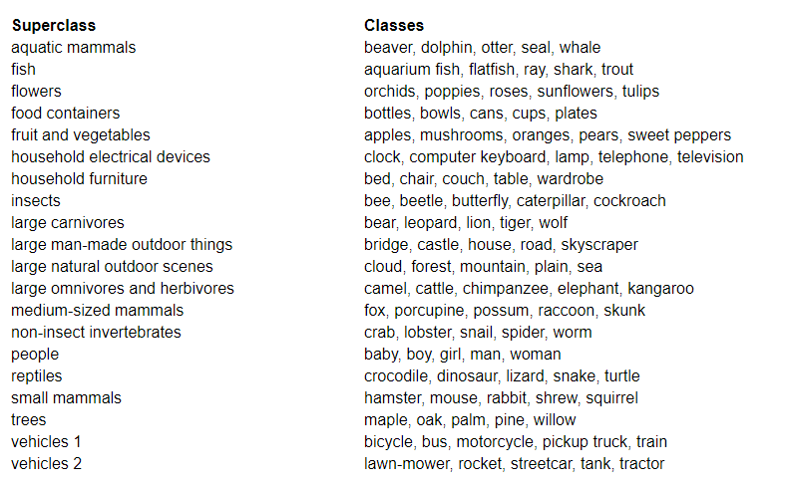
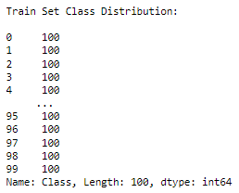
Default Dataset - CIFAR100
The dataset consists of 60000 colored images (50000 training and 10000 test) of 32 × 32 pixels in 100 classes grouped into 20 superclasses. Each image has a fine label (class) and a coarse label (superclass).

Slide 4
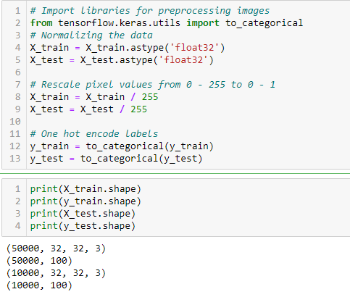
DATA PREPROCESSING
-Normalize the data
-Scaled the values to a range of 0 to 1 before feeding to the neural network model.
-Divide the values by 255.
The training set and the testing set are preprocessed in the same way

Slide 5
Data preparation/Features engineering
Verify that the data is in the correct format to build and train the network

Slide 6
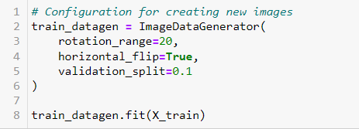
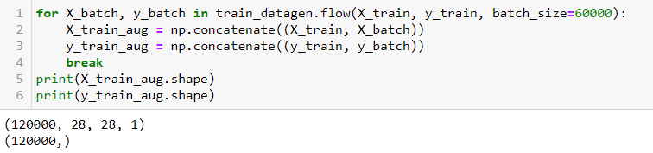
DATA AUGMENTATION
Rotation- The images are rotated randomly from 0-20 degrees
Horizontal flip - The images are flipped horizontally
Validation split - Fraction of images reserved for validation
Adding the Augmented Data to the default data
- Number of Rows x 2

Slide 7
Training Process- Refer to code
Plot accuracy on the training and validation datasets over training epochs.
Plot loss on the training and validation datasets over training epochs.
Early Stopping function - a callback that allows you to specify the performance measure to monitor, the trigger, and once triggered, it will stop the training process.
Define CNN Model
Define loss, optimizer, learning rate, metrics

Slide 8
Model Evaluation – Baseline Model (Without Data Augmentation)
Val loss: 3.359
Val accuracy: 0.221
Validation loss and training loss are both high
This may indicate that the model is underfitting
Occurs when the model is unable to accurately model the training data, and hence generates large errors.

Slide 9
Model Evaluation – Baseline Model (With Data Augmentation)
Val loss: 3.465
Val accuracy: 0.193
Validation loss is staying close with training loss but both still having high loss
Both showing low accuracy

Slide 10
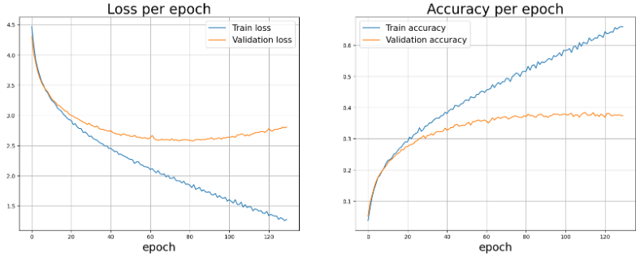
Model Evaluation – Improved Model1 (Without Data Augmentation)
Val loss: 2.712
Val accuracy: 0.384
Validation loss overfitting
Low validation accuracy and high validation loss

Slide 11
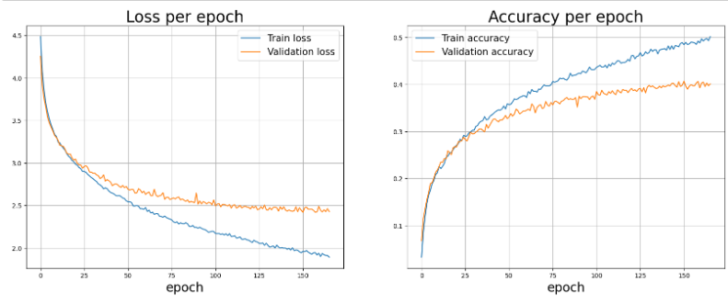
Model Evaluation – Improved Model1 (With Data Augmentation)
Val loss: 2.420
Val accuracy: 0.407
The train and validation curves are improving but both still showing high loss and low accuracy
Overfitting has been improved

Slide 12
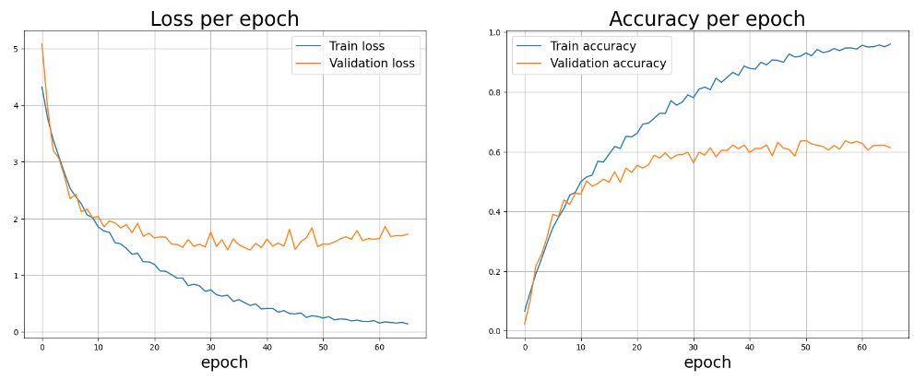
Model Evaluation – Improved Model2 (Without Data Augmentation)
Val loss: 1.550
Val accuracy: 0.637
Higher validation accuracy and lower validation loss

Slide 13
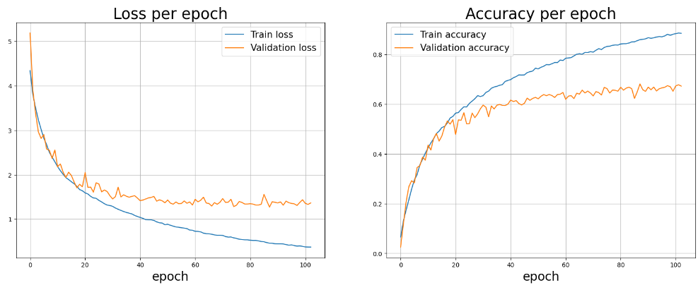
Model Evaluation – Improved Model2 (With Data Augmentation)
Val loss: 1.266
Val accuracy: 0.676
Higher validation accuracy and lower validation loss

Slide 14
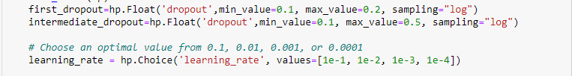
Hypertuned Improved Model 2
Hyperparameter Search (Keras Tuner: Random Search)
Parameters input dropout to between 0.1 and 0.2 because dropping the input data can adversely affect the training.
Parameters intermediate dropout to 0.5 and below because 0.5 is ideal for large datasets and >0.5 is not advised it may cull more connections without boosting the regularization.

Slide 15
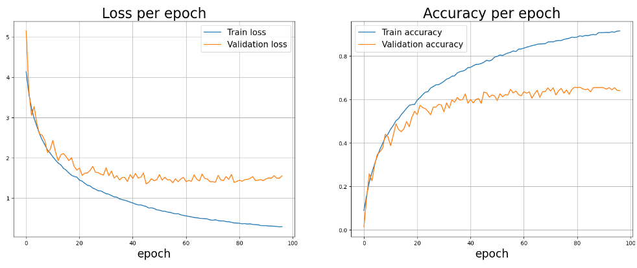
Hypertuned Improved Model 2
Val loss: 1.415
Val accuracy: 0.656
Hyperparameter Search (Keras Tuner: Random Search)
Higher validation accuracy and lower validation loss but still lower than improved model 2
This may be because I did not run enough parameters through the hypertuning.

Slide 16
Performance Evaluation-Improved Model 2

Slide 17
Performance Evaluation-Improved Model 2

Slide 18
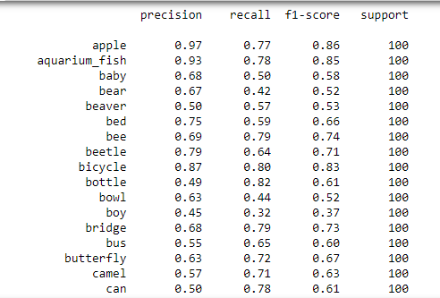
Performance Evaluation-Improved Model 2 (AFTER Hypertuning)

Slide 19
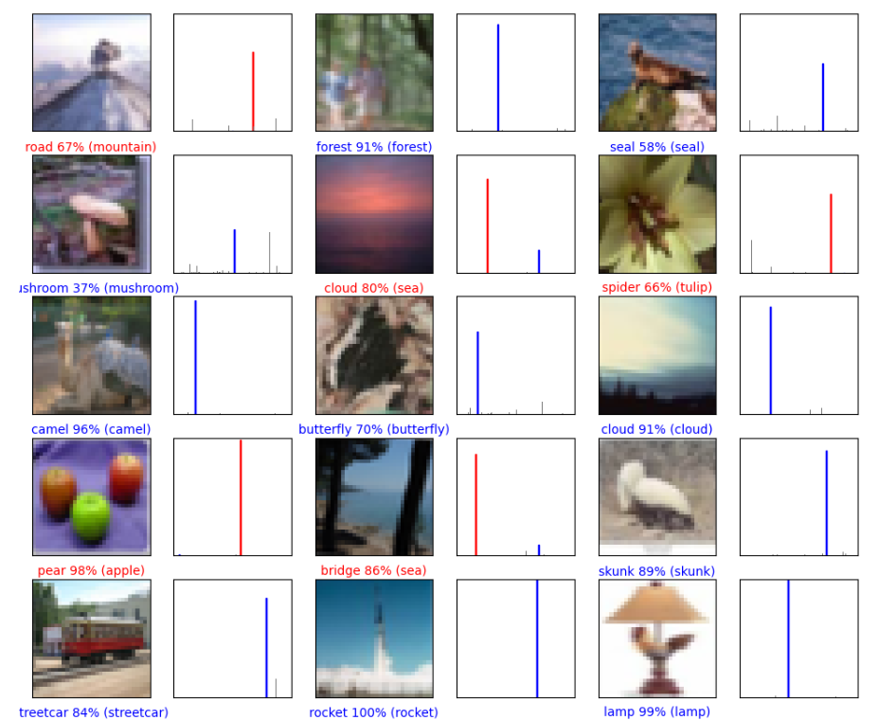
Performance Evaluation-Improved Model 2 (AFTER Hypertuning)

Slide 20
Conclusion-Data Augmentation
The Data Augmentation is very useful in the CIFAR100 dataset as the validation accuracy is low and the validation loss is high.
- Due to each image is not standard for each class ( for example: each image are roughly shown, so it will help improve the data training better.)

Slide 21
Conclusion on Model Improvement
Model | Validation Loss | Validation Accuracy
Base model | 3.359 | 0.2205
Base model + Augmented | 3.465 | 0.1935
Improved Model1 (without Augmented) | 2.618 | 0.3752
Improved Model1 (with Augmented) | 2.678 | 0.3452
Improved Model1 (Augmented + Default) | 2.419 | 0.4065
Improved Model2 (norm without Augmented) | 1.550 | 0.6372
Improved Model2 (norm with Augmented) | 1.298 | 0.6867
Improved Model2 (norm with Augmented + Default) | 1.266 | 0.6760
Tuned_Model | 1.415 | 0.6562
Improved Model2 (norm with Augmented)is the best performance model in this study

